Slide 1
BAGGAGE TRACKING SYSTEMS
SUBMITED BY,

Slide 2

What is the problem?

Slide 3

Problems in baggage handling
Loss of time.
No prediction of movement of baggage
Assumption of arrival will not be there

Slide 4

Electromagnetic tags

Slide 5
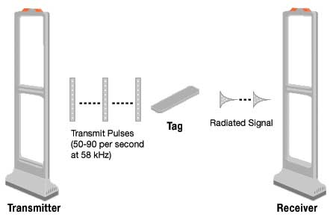
Electromagnetic Article Surveillance (EAS)

Slide 6

Airport baggage system

Slide 7
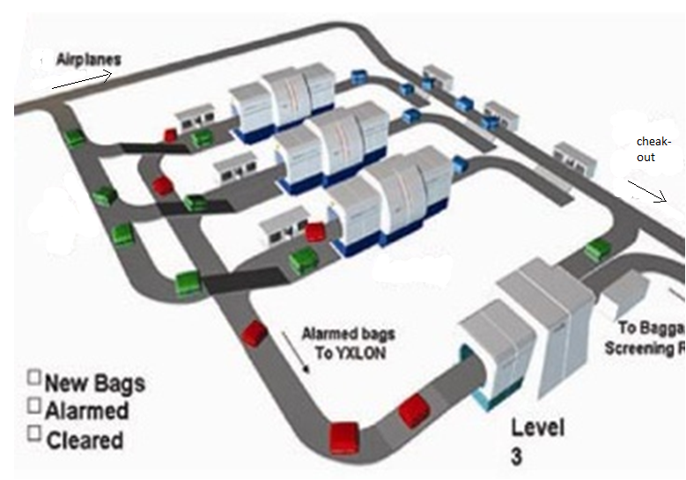
Working

Slide 8
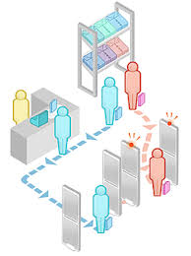
Protection

Slide 9
Thank you

